Slide 1
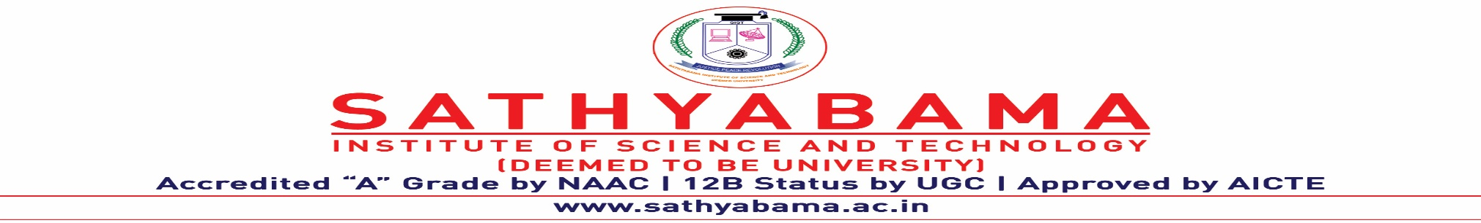

INTERNET Of THINGS - SITA3008
UNIT-I

Slide 2

What is IoT?
The "things" that make up the emerging "Internet of Things" range from tractors to thermostats to shipping containers.
Internet of Things – The idea of physical objects communicating and interacting with each other online is referred to as the Internet of Things.
It is a network of physical objects or things sending, receiving, or communicating using the internet or other communication technologies.

Slide 3

The "things" that make up the emerging "Internet of Things" range from tractors to thermostats to shipping containers.
Internet of Things – The idea of physical objects communicating and interacting with each other online is referred to as the Internet of Things.
It is a network of physical objects or things sending, receiving, or communicating using the internet or other communication technologies.

Slide 5
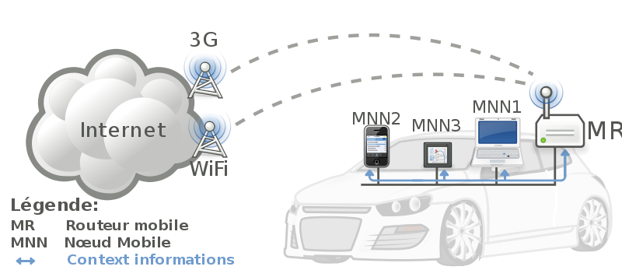


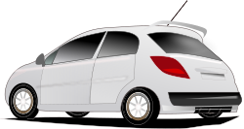
IoT: Things connecting with Things
- Complex and heterogeneous
resources and networks

Slide 6
IoT
IoT is a platform where embedded devices are connected to the internet, so they can collect and exchange data with each other.
It enables devices to interact, collaborate and learn from each other’s experiences just like humans do.
It has dynamic global network infrastructure with self-configuring capabilities based on standard and interoperable communication protocols where physical and virtual “things” have identities, physical attributes and virtual network and use intelligent interfaces.

Slide 7
Father of IoT
Kevin Ashton is an innovator and consumer sensor expert who coined the phrase “the Internet of Things” to describe the network connecting objects in the physical world to the Internet.

Slide 8
World’s first IoT
The world's first IoT device was invented in the early 1980s at the Carnegie Mellon University.
Coca-Cola vending machine – to report if the machine was out of coke.

Slide 9
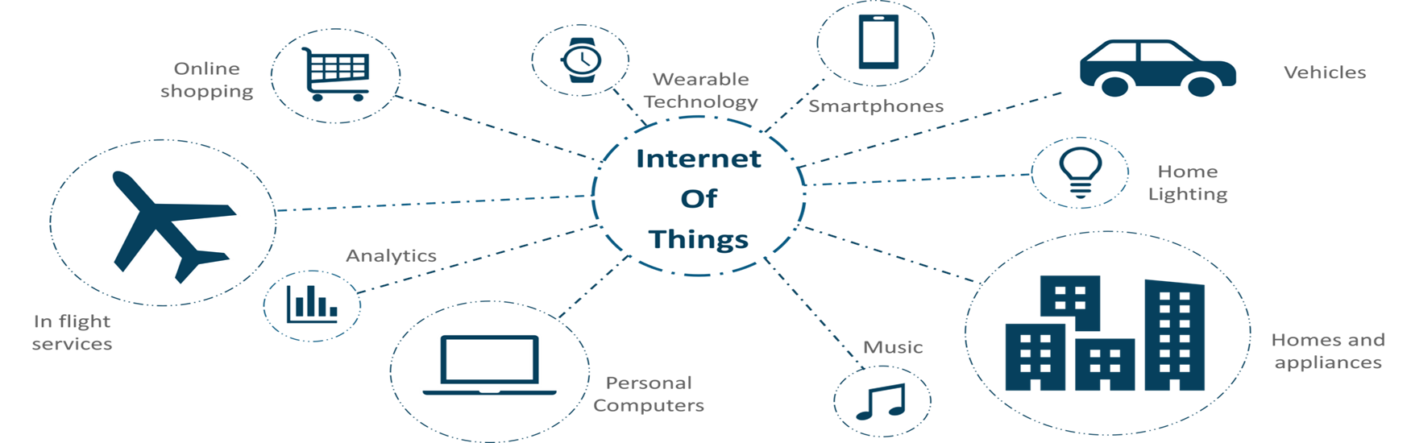
IoT in our everyday life

Slide 10
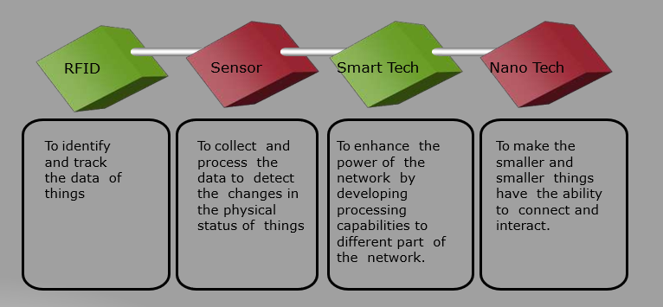
How IOT Works

Slide 11

IoT Technologies
Hardware (Device)
Communication Technology
Protocols for IoT
Software (IDE)
Cloud Platforms

Slide 12
IoT Hardware
Routers, switches, bridges and sensors
Arduino Uno/ Raspberry pi/ Beagle board
Wearable electronic devices
Basic devices (Desktop, laptop, tablet, smartphone)

Slide 13
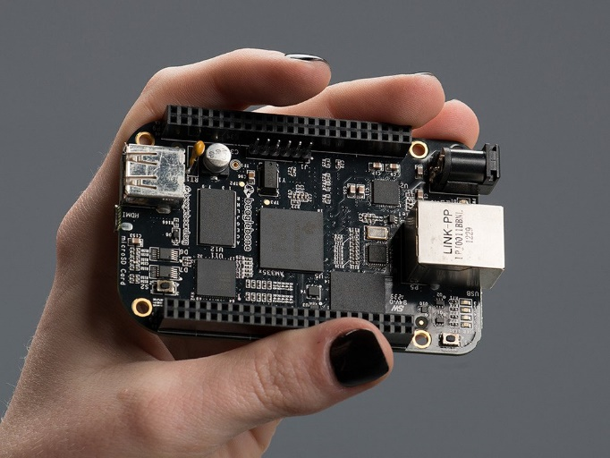
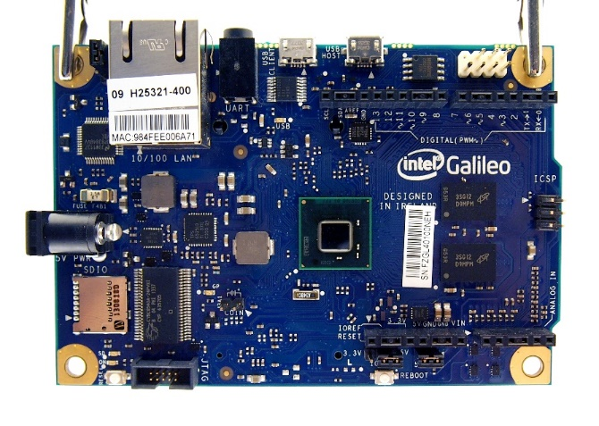
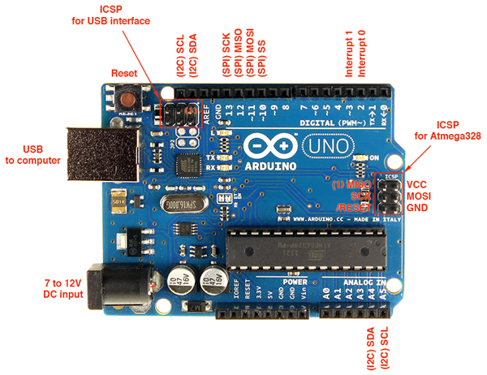
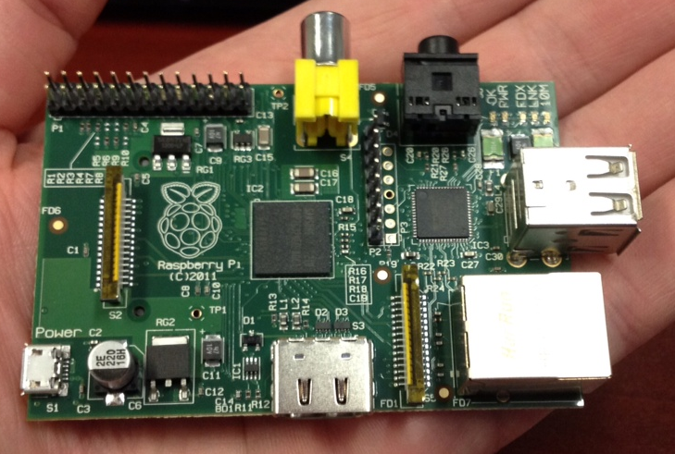
Implementing Smart Objects
Beaglebone black
Intel Galileo
Raspberry Pi
Arduino Uno

Slide 14
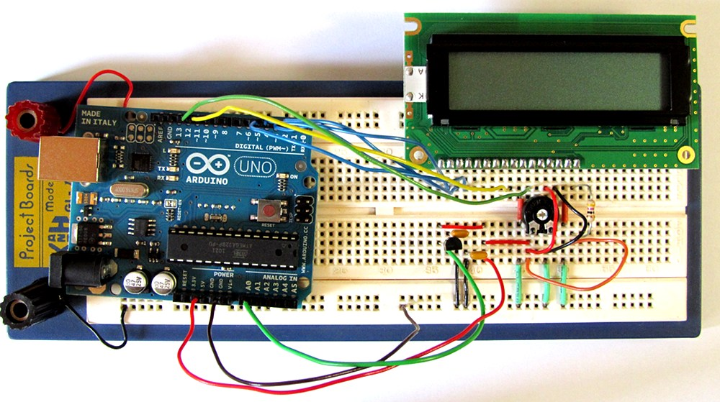
Board Connection

Slide 15
Hardware
Bridges – Connect two motorways and sensors, provide a constant stream of information.
Router – To connect multiple networks and forward packets destined for its networks.
Gateway – Connection point between the cloud and controllers, sensors and intelligent devices.
IoT Hub – Supports communication both from the device to the cloud and from the cloud to the device.

Slide 16
SENSOR
A sensor is a device, which detects events or changes in its environment and sends the information to a computer processor. A sensor is always used with other electronics.
The sensor converts the physical gesture into electrical signals.
Types of sensors
Temperature sensors
IR sensors
Ultrasonic sensors
Pressure sensors
Proximity sensors
Touch sensors

Slide 17
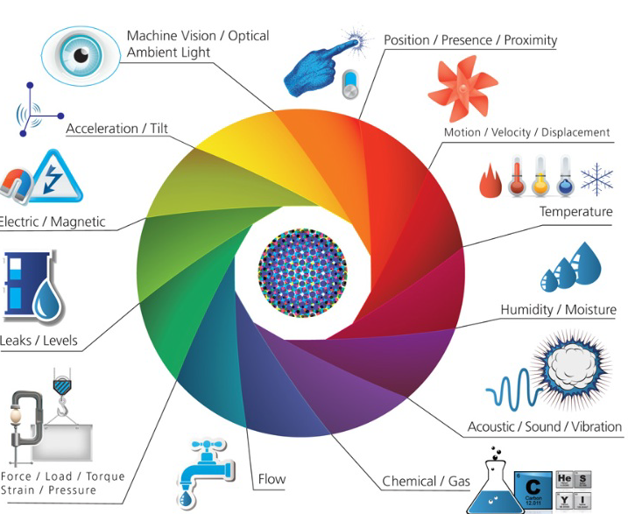
Sensors and Actuators

Slide 18
An actuator is a device that uses a form of power to convert a control signal into mechanical motion.
The actuator is responsible for the conversion of electrical signal to mechanical work.
Examples
Electric motors, stepper motors, jackscrews, electric muscular
stimulators in robots

Slide 19
IoT Software
Linux or Unix like OS / Android
C, C++
Java
Python
C#

Slide 20
CURRENT TECHNOLOGICAL TRENDS AND FUTURE PROSPECTS
IoT and Security Attacks
Countless Internet of Things (IoT) devices that power everyday technology like closed-circuit cameras and smart-home devices were hijacked by the malware, and used against the servers.
IoT and Mobile Elements
More mobile moments (the moments in which a person pulls out a mobile device to get what he or she wants, immediately and in context) will appear on the connected device, right from home appliances to cars to smartwatches and virtual assistants.

Slide 21
CURRENT TECHNOLOGICAL TRENDS AND FUTURE PROSPECTS
IoT and artificial Intelligence
Review and analyzes the data we’ve collected to find patterns or similarities that can be learned from so that better decisions can be made.
IoT and Connectivity
Wi-Fi, Bluetooth, Low Power Wi-Fi, Wi-Max, regular Ethernet, Long Term Evolution (LTE) and the recent promising technology of Li-Fi

Slide 22
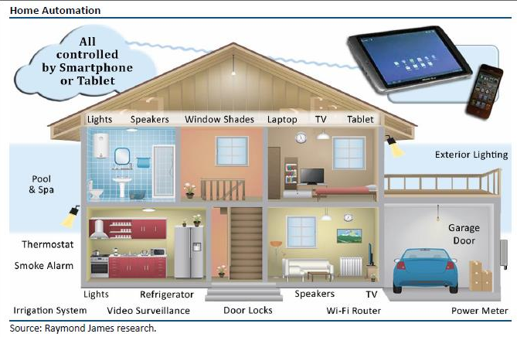
IoT Applications : Intelligent Home

Slide 23
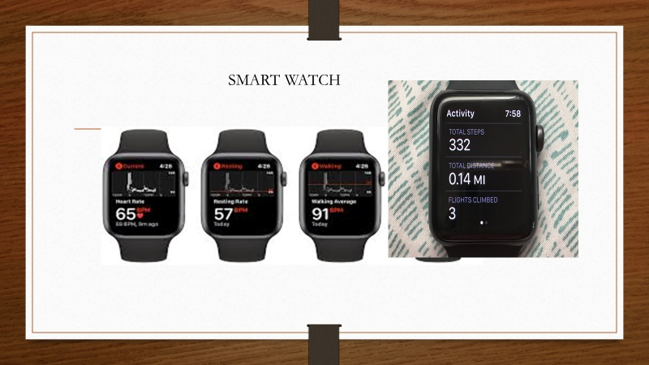
SMART WATCH

Slide 24
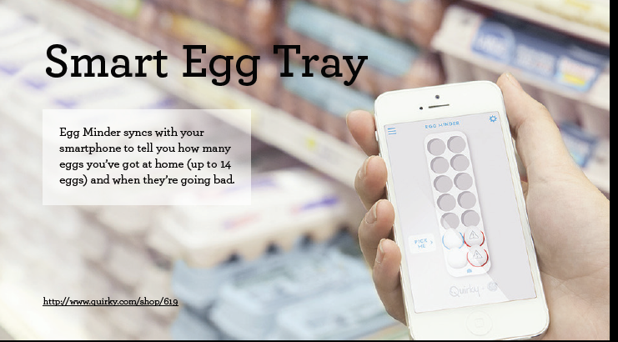

Slide 25
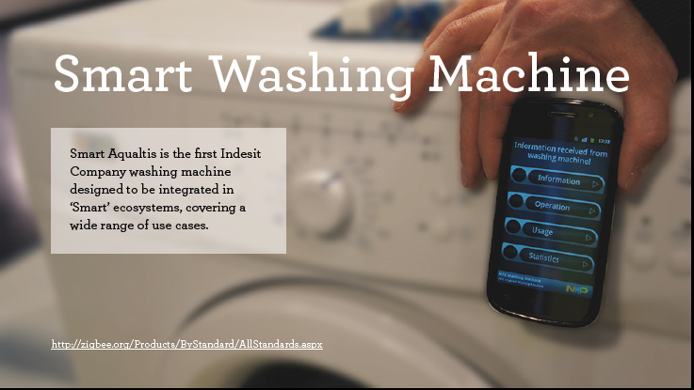

Slide 26
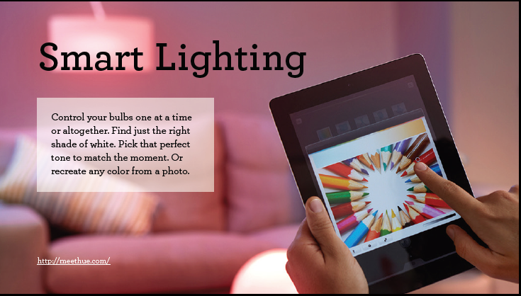

Slide 27
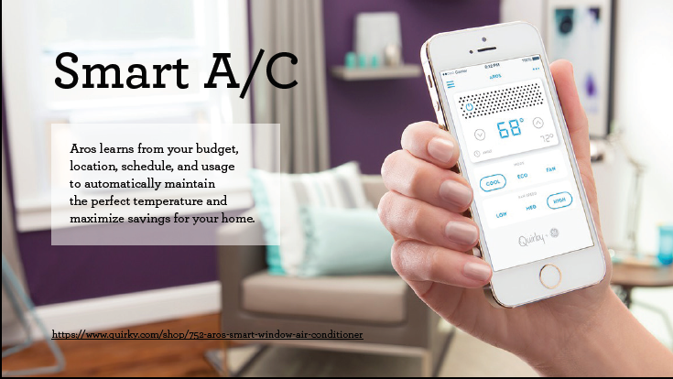

Slide 28
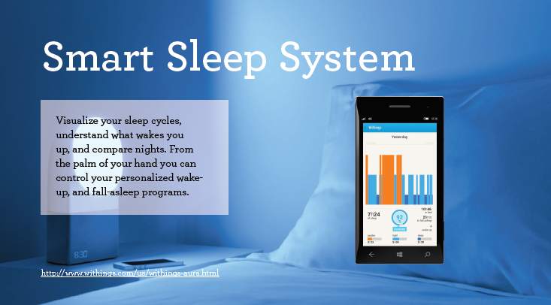

Slide 29
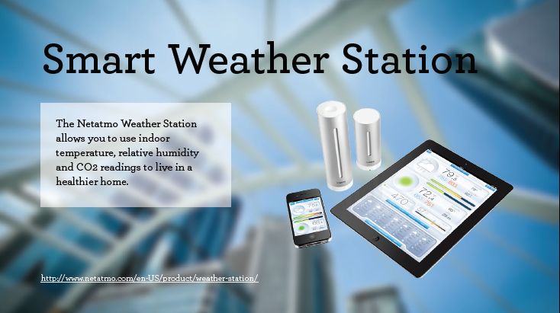

Slide 30
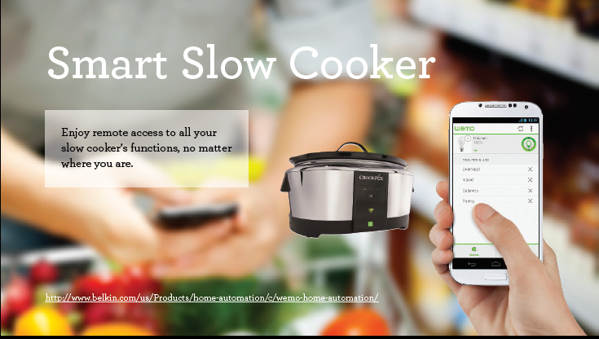

Slide 31
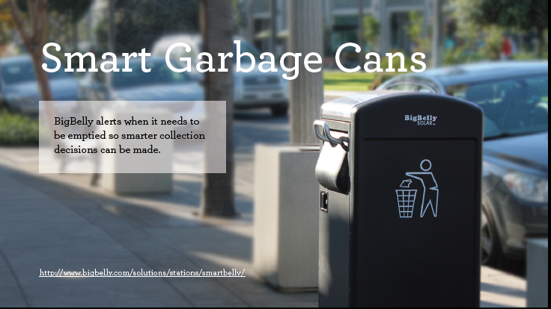

Slide 32
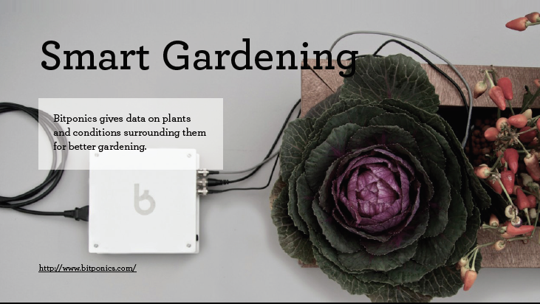

Slide 33
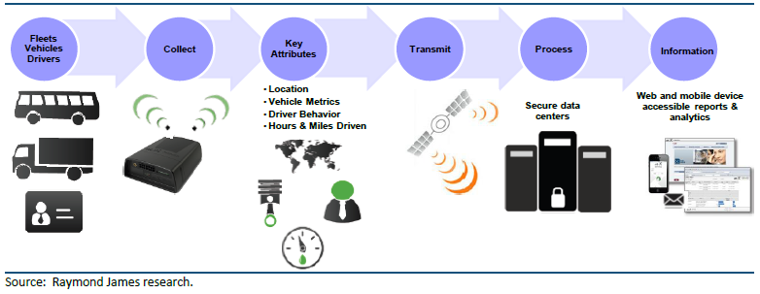
IoT Applications : Transportation

Slide 34
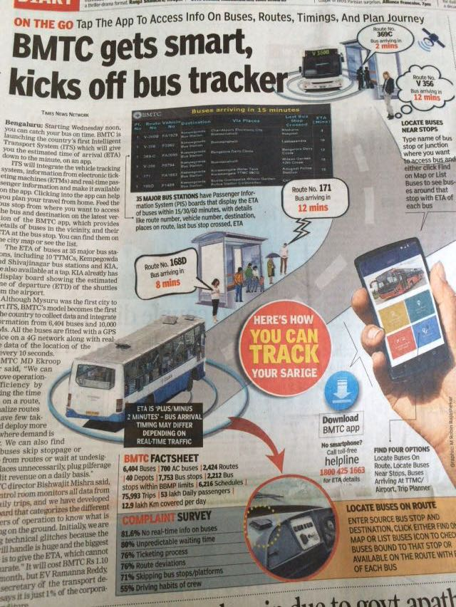
IoT Applications : (BMTC)Transportation

Slide 35


Slide 36
EVOLUTION OF IOT AND BUSINESS SCOPE
The term “Internet of Things” (IoT) was first used in 1999 by British technology pioneer Kevin Ashton to describe a system in which objects in the physical world could be connected to the Internet by sensors.

Slide 37
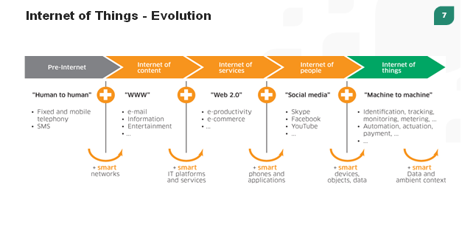
EVOLUTION

Slide 38
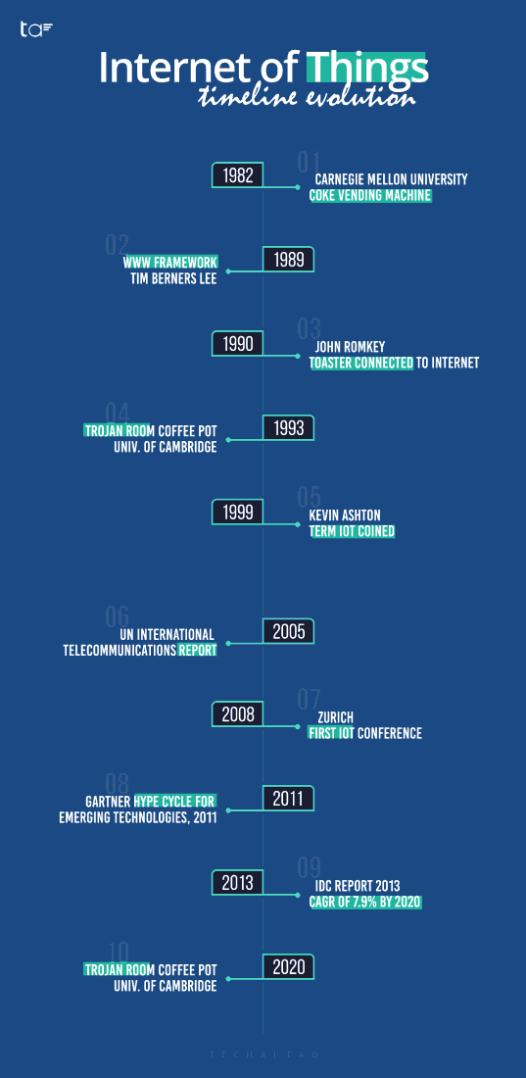
EVOLUTION

Slide 39
IoT - Evolution
Ubiquitous Connectivity—Low–cost, high–speed, pervasive network connectivity, especially through licensed and unlicensed wireless services and technology, makes almost everything “connectable’’.
Widespread adoption of IP–based networking— IP has become the dominant global standard for networking, providing a well–defined and widely implemented platform of software and tools that can be incorporated into a broad range of devices easily and inexpensively.
Miniaturization— Manufacturing advances allow cutting-edge computing and communications technology to be incorporated into very small objects. Coupled with greater computing economics, this has fueled the advancement of small and inexpensive sensor devices, which drive many IoT applications.

Slide 40
Advances in Data Analytics— New algorithms and rapid increases in computing power, data storage, and cloud services enable the aggregation, correlation, and analysis of vast quantities of data; these large and dynamic datasets provide new opportunities for extracting information and knowledge.
Rise of Cloud Computing– Cloud computing, which leverages remote, networked computing resources to process, manage, and store data, allows small and distributed devices to interact with powerful back-end analytic and control capabilities.

Slide 41
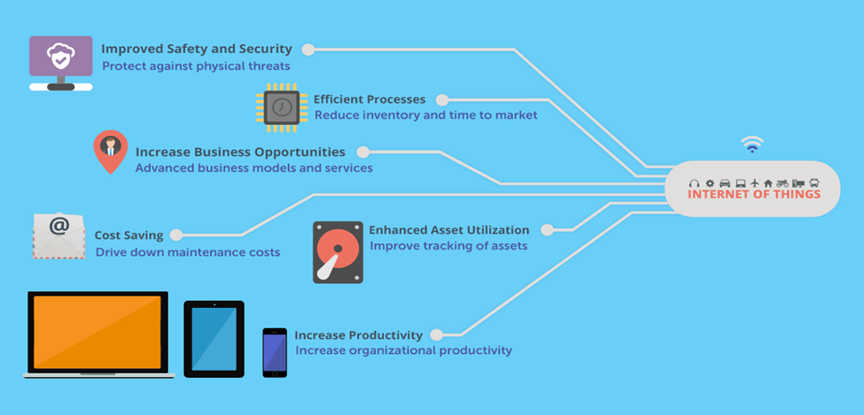
Business Scope

Slide 42
BUSINESS SCOPE
Increase Business Opportunities
IoT-driven innovations build strong business cases, reduce time to market and increase return on investments.
IoT has the potential to transform the way consumers and businesses approach the world by leveraging the scope of the IoT beyond connectivity.
Enhanced Asset Utilization
IoT will improve tracking of assets (equipment, machinery, tools, etc.) using sensors and connectivity, which helps organizations benefit from real-time insights. Organizations could more easily locate issues in the assets and run preventive maintenance to improve asset utilization.

Slide 43
BUSINESS SCOPE
Efficient Processes
IoT allow businesses to be smarter with real-time operational insights while reducing operating costs.
The data collected from logistics network, factory floor, and supply chain will help reduce inventory, time to market and downtime due to maintenance.
Improved Safety and Security
IoT services integrated with sensors and video cameras help monitor workplace to ensure equipment safety and protect against physical threats.
The IoT connectivity coordinates multiple teams to resolve issues promptly.

Slide 44
How IoT Impacts Business?
Inventory Tracking & Management
Enhanced Productivity & Efficiency
Remote Working
Perception & Data Sharing

Slide 45
Future of IoT
The progress of the industrial internet would be transformed via enhanced network strength, integrated Artificial Intelligence, and the ability to deploy, automate, arrange and secure various use cases on a large scale.
The main purpose of IoT is not only to connect billions of devices seamlessly but also to make use of a large amount of data that could automate various business processes.

Slide 46
IoT Business Opportunity
Medical & Fitness
IIoT
Smart Cities
Smart Parking
Street Lighting
IoT Toys
Cars
Territory IoT Monitoring

Slide 47
Customer Appliances
IoT in Healthcare
Remote Operations
Blockchain
The Rise of IoMT

Slide 48
The relation between Embedded Systems and IoT
Embedded systems – microwave oven, washing machine, remote control, RFID tags, routers, modems, PDAs, mobile phones etc.
Embedded system is a computer system—a combination of a computer processor, computer memory, and input/output peripheral devices. Its basically a combination of both hardware and software.
Arduino is an embedded board

Slide 49
Embedded System
Embedded systems are part and parcel of every modern electronic component. These are low power consumption units that are used to run specific tasks for example remote controls, washing machines, microwave ovens, RFID tags, sensors, actuators and thermostats used in various applications, networking hardware such as switches, routers, modems, mobile phones, PDAs, etc.
They differ from PCs in their size and processing power. Embedded systems typically have a microprocessor, a memory, and interfaces with the external world.
but they are considerably smaller than their PC counterparts. Frequently, the bulk of the electronic circuitry can be found in a single chip

Slide 50
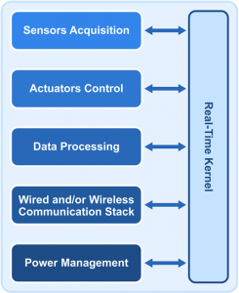

Slide 51
A sensor detects (senses) changes in the ambient conditions or in the state of another device or a system, and forwards or processes this information in a certain manner.
Analog Sensors produce a continuous output signal or voltage which is generally proportional to the quantity being measured.
Physical quantities such as Temperature, Speed, Pressure, Displacement, Strain etc. are all analog quantities as they tend to be continuous in nature.
Digital Sensors produce discrete digital output signals or voltages that are a digital representation of the quantity being measured.
Digital sensors produce a binary output signal in the form of a logic “1” or a logic “0”, (“ON” or “OFF”).
An actuator is a component of a machine or system that moves or controls the mechanism or the system. An actuator is the mechanism by which a control system acts upon an environment

Slide 52
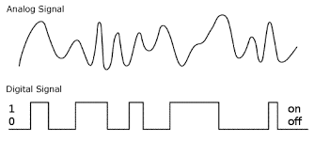
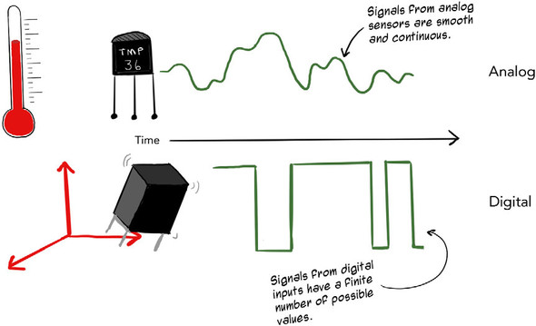

Slide 53
Programming Languages
The programming languages used in deeply embedded systems include C, C++ and sometimes Java.
It is important to note that Java always runs on top of an operating system. So, your choice is not between C/C++ or Java
Java is attractive for IoT devices because the number of Java developers worldwide brings tremendous growth potential to the industry. Oracle’s Java ME Embedded is designed for small devices

Slide 54
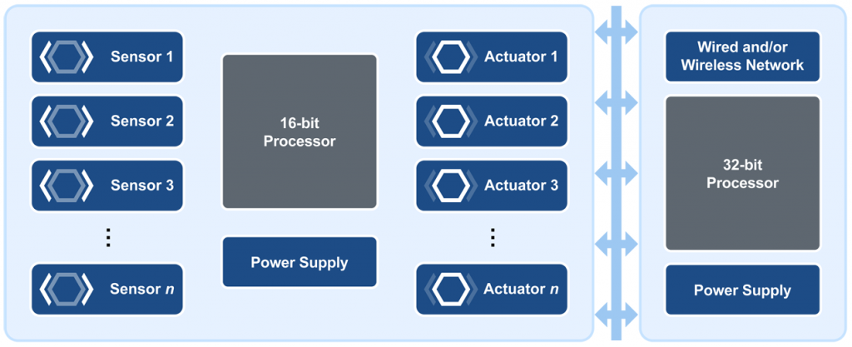
IoT Devices with Two Processors

Slide 55
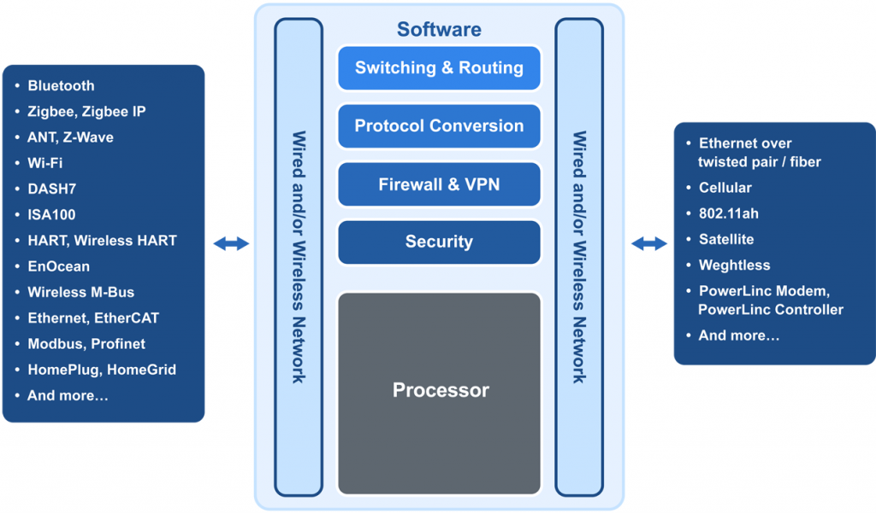
Gateway Design

Slide 56
Bluetooth is a wireless technology standard for exchanging data over short distances from fixed and mobile devices, and building personal area networks.
Zigbee wireless technology is specially designed for sensors and control devices that employ low cost connectivity and widely used for several applications.
Z-Wave is a wireless communications protocol used primarily for home automation. It is a mesh network using low-energy radio waves to communicate from appliance to appliance, allowing for wireless control of residential appliances and other devices, such as lighting control, security systems, thermostats, windows.

Slide 57
Wi-Fi is the name of a popular wireless networking technology that uses radio waves to provide wireless high-speed Internet and network connections. A common misconception is that the term Wi-Fi is short for "wireless fidelity.
ISA100.11a is a wireless networking technology standard developed by the International Society of Automation (ISA). The official description is "Wireless Systems for Industrial Automation: Process Control and Related Applications.
The EnOcean technology is an energy harvesting wireless technology used primarily in building automation systems, and is also applied to other applications in industry, transportation, logistics and smart homes. Modules based on EnOcean technology combine micro energy converters with ultra low power electronics, and enable wireless communications between batteryless wireless sensors, switches, controllers and gateways.

Slide 58
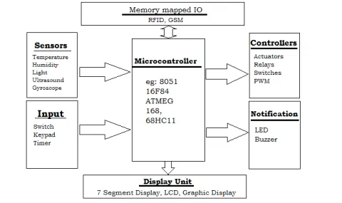
Embedded systems hardware

Slide 59
Processors
Embedded processors can either be a microprocessor or a microcontroller. Microprocessors needs separate integrated circuits for memory and peripherals whereas microcontrollers have on-chip peripherals which reduces power consumption, size and its cost. They include the following:
Microcontroller (CPU)
System on Chip (SoC)
ASIC processor
DSP processor

Slide 60
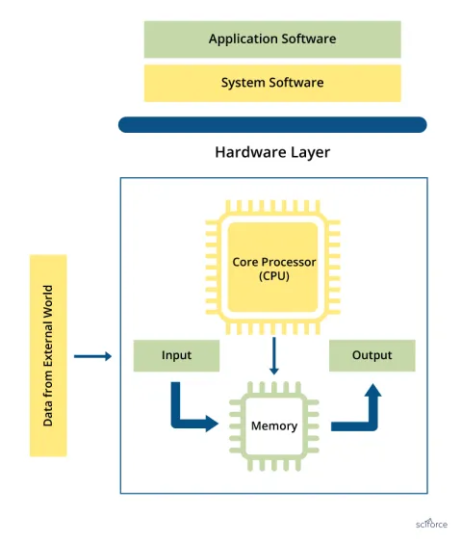
Embedded software
Device Driver
Operating System (OS) or MicroOS

Slide 61
Role of Embedded systems in the Internet of Things
Internet of Things is the concept of connecting devices via the internet to exchange data
The Internet of Things (IoT) is a process in which objects are equipped with sensors, actuators, and processors that involve hardware board design and development, software systems, web APIs, and protocols, which together create a connected environment of embedded systems.

Slide 62
Role of Embedded systems in the Internet of Things
There are several challenges designers face in designing a hardware system for embedded IoT devices which include:
Lack of necessary flexibility for running applications over embedded systems.
The security crisis in embedded system design.
High power dissipation of embedded system design
Problems of testing the design
Also, Inadequate functional safety of safety-critical embedded systems
Finally, Increased cost and time-to-market

Slide 63
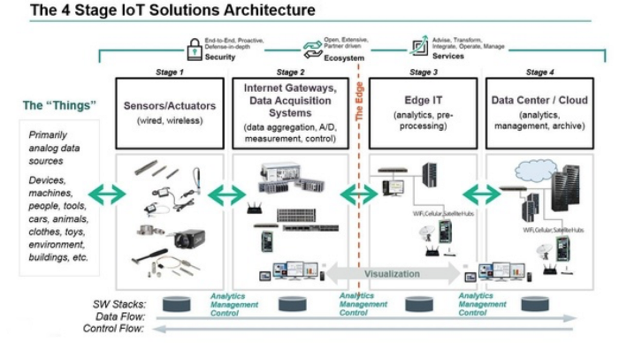
IOT architecture

Slide 64
Sensing Layer (wireless sensors and actuators)
The sensor layer has the responsibility to recognize things and gather the data from them.
There are many types of sensors connected to the objects to gather information such as RFID, sensors and 2-D barcode.
The sensors are selected as per the requirement of applications. The data that is collected by these sensors can be about location, changes in the air, environment, etc.
However, they are the main aim of attackers who wish to use them to replace the sensor with their own.

Slide 65
Threats related to sensor
Replay Attack:
Eavesdropping:
Timing Attack:

Slide 66
Sensor data aggregation systems and analog-to-digital data conversion
This layer is also known as a transmission layer.
It acts like a bridge that carries and transmits data gathered from physical objects through sensors.
The medium can be wireless or wire-based. It also connects the network devices and networks to each other.
Hence, it is extremely sensitive to attacks from the attackers.
It has important security issues regarding integrity and authentication of data that is being transmitted to the network.

Slide 67
Common issues and threats of the Network layer are:
Main-in-The-Middle Attack:
Storage Attack:
Exploit Attack:

Slide 68
Data Processing Layer
In three-layer architecture, the data were directly sent to the network layer.
Due to sending data directly the chances of getting damages increase. In four-layer architecture, data is sent to this layer that is obtained from a perception layer.
Data Processing Layer has two responsibilities it confirms that data is forwarded by the authentic users and prevented from threats.
Authentication is the most commonly used method to verify the users and the data.
It is applied by using pre-shared, keys and passwords to the concerned user.
The second responsibility of the layer is to send information to the network layer.
The medium through which data is transferred from the Data Processing Layer to the network layer can be wireless and wire-based.

Slide 69
Common issues and threats of the Data Processing layer are:
DoS Attack:
Malicious Insider Attack:

Slide 70
Application Layer
The application layer defines all applications in which IoT has deployed. It is the interface between the end IoT devices and the network. IoT Applications such as smart homes, smart health, smart cities, etc. It has the authority to provide services to the applications. The services may be different for each application because of services based on the information collected by sensors.
It is applied through a dedicated application at the device end. Such as for a computer, the application layer is applied by the browser. It is the browser that executes application layer protocols like HTTP, HTTPS, SMTP, and FTP. There are many concerns in the application layer out of which security is the key issue.

Slide 71
Common issues and threats of application layers are:
Cross-site scripting:
Malicious Code Attack:

Slide 72
Delivering Business Value with IOT enabled Infrastructure Management
IoT enabled infrastructure Management is the art of knowing the condition of your assets before you act on them. Knowing in such detail, that failure prediction and preventive action becomes a reliable and efficient infrastructure management strategy.
Knowledge-based Infrastructure Management requires frequent collection of data. It includes data collection of the infrastructure itself but also of the corresponding throughput it facilitates. And, of the external circumstances in which the infrastructure operates.

Slide 73
Delivering Business Value with IOT enabled Infrastructure Management
And, of the external circumstances in which the infrastructure operates. In fact, the condition of the infrastructure and the way it changes or deteriorates over time must be compared with load, volume, and variability data over time. Also, external conditions like temperature, moisture, terrain conditions, etc. may affect failure risks and the rate of degradation.
Analysing breakdown events or loss of performance by looking at the corresponding data prior to the event, statistical decision support models can be built. It tells you with a high degree of accuracy when to do maintenance. And, it indicates when to replace infrastructure components in order to prevent critical events. In this way, you manage your operational risks at the lowest possible cost.

Slide 74
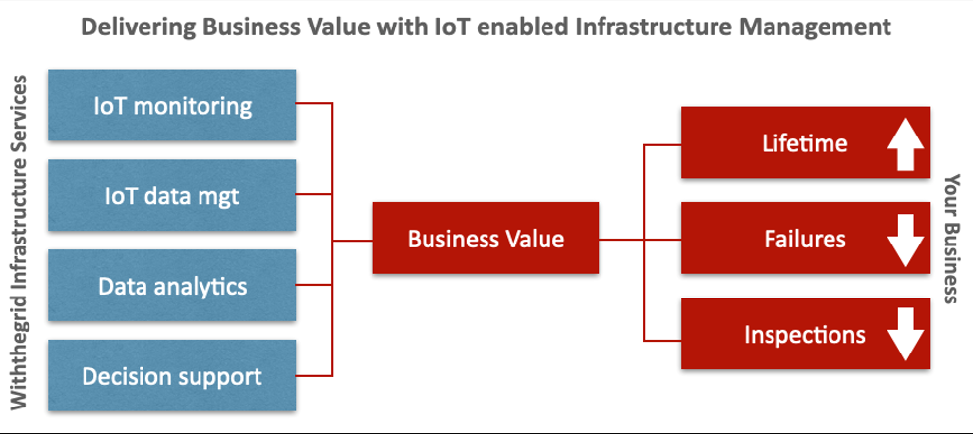
Delivering Business Value with IOT enabled Infrastructure Management

Slide 75
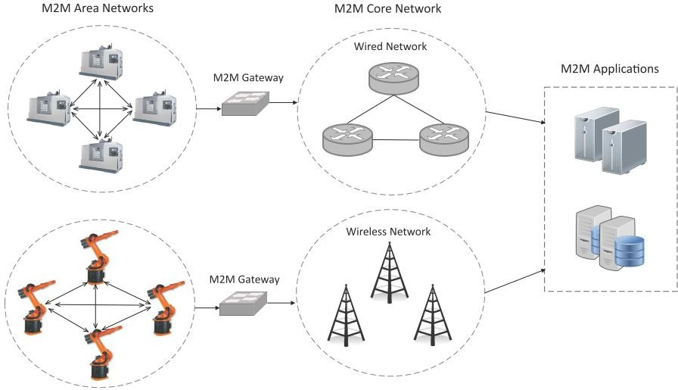
FROM M2M to IOT
IoT M2M, Machine to machine verbal exchange, is two machines “speaking,” or exchanging information, without human interplay.
Examples
Vending machines sending out inventory records
ATM machines getting authorization to dispense cash.

Slide 76
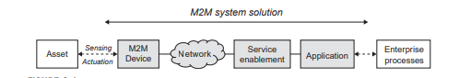
The system components of an M2M
M2M Device
Network
M2M Service Enablement
M2M Application

Slide 77
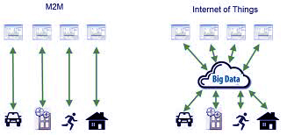
How IoT M2M Works?
M2M is among the fastest-growing forms of connected tool technologies inside the marketplace proper now, largely due to the fact M2M technology can connect millions of gadgets inside an unmarried community.

Slide 78
M2M communication is the data flow among people, devices, and systems.
Basic elements for M2M are
Embedded Processor for storing data
Communication Technology for transfer of data
Management Applications for monitoring and control
M2M stands for machine-to-machine, mobile-to-machine, or man-to-machine communication

Slide 79
The main purpose of machine-to-machine technology is to tap into sensor data and transmit it to a network.
The main components of an M2M system include sensors, RFID, a Wi-Fi or cellular communications link, and autonomic computing software programmed to help a network device interpret data and make decisions.
Benefits of M2M
Reduced costs by minimizing equipment maintenance and downtime;
Boosted revenue by revealing new business opportunities for servicing products in the field; and
Improved customer service by proactively monitoring and servicing equipment before it fails or only when it is needed.

Slide 80
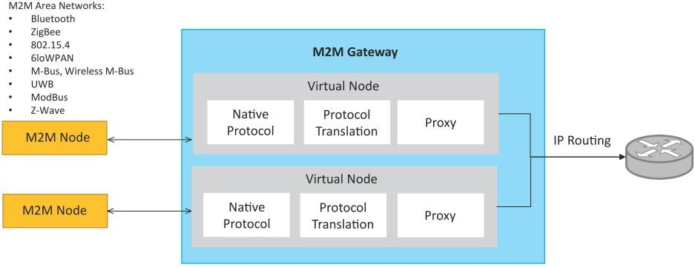
M2M gateway
Since non-IP based protocols are used within M2M area networks, the M2M nodes within one network cannot communicate with nodes in an external network.
To enable the communication between remote M2M area networks, M2M gateways are used.

Slide 81
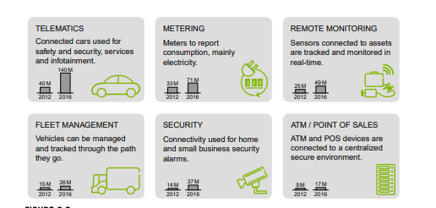
IoT M2M Applications

Slide 82
M2M requirements
Scalability
Anonymity
Logging
M2M application communication principles
Delivery methods
Message transmission scheduling
Message communication path selection

Slide 83
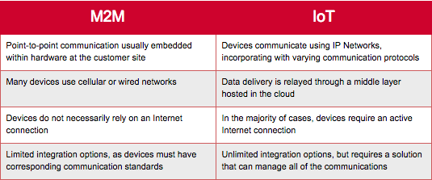
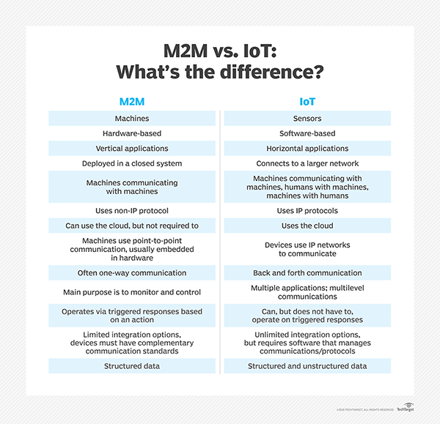
M2M vs IoT

Slide 84
M2M towards IOT
The need to remotely monitor and control assets,personal, enterprise or other , is not new, a number of concurrent things are now converging to create drivers for change not just within the technology industry, but within the wider global economy and society
The transition from M2M towards IoT is one of the key facets of the technology evolution required to face these challenges
The game changers come from a set of social, economic, and environmental shifts that create pressure for solutions to address issues and problems, but also opportunities to reformulate the manner in which our world faces them.

Slide 85
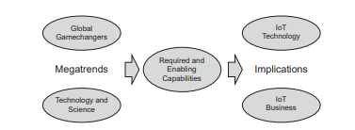
M2M towards IOT

Slide 86
Global value chains
A value chain describes the full range of activities that firms and workers perform to bring a product from its conception to end use and beyond, including design, production, marketing, distribution, and support to the final consumer.
GVC analysis therefore provides a holistic view of global industries both from the top down and from the bottom up

Slide 87
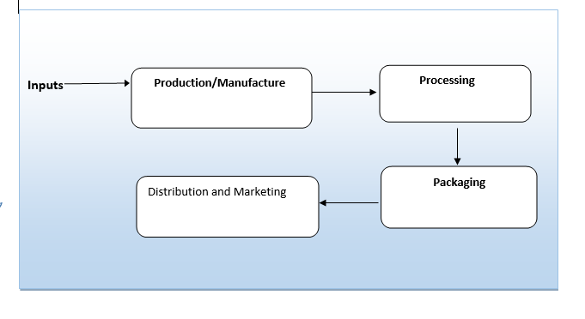
M2M value chain

Slide 88
Global Value chain
Input | Input are the base raw ingredients that turned into a product
Example | Cocoa beans for the manufacture of chocolate
M2M Example | Data from a M2M device that will be turned into a piece of information
Production/Manufacture | Raw ingredients put through to become part of value
Example | Cocoa beans may be dried and separated before being transported to overseas market
M2M Example | Data from an M2M device that will be turned into a piece of information
Processing | Processing refers to the process that the raw inputs are put through become a part of value chain
Example | Cocoa beans now be made into cocoa powder ready for use in chocolate bars
M2M Example | M2M refers to aggregation of multiple data sources to create a information component something that is ready to combined with other data sets to make it useful for corporate decision making

Slide 89
Global Value chain
Packaging | Packaging refers to the process where by a product can be branded as would be recognizable to end user consumers
Example | A chocolate bar would now be ready to eat and have a red wrapper with the words KitKat on it
M2M Example | M2M data will have to be combined with other information from internal corporate databased for example to see whether the data received requires any action. This data would be recognizable to the end users that need to use the information, either in the form of visualizations or an Excel spreadsheet
Distribution/Marketing | This process refers to the channels to market for products
Example | A chocolate bar may be sold at a supermarket a kiosk or even online
M2M Example | Will have produced an Information product that can be used to create new knowledge within a corporate environment examples include more detailed scheduling of maintenance based on real world information or improved product design due to feedback from the M2M solution.

Slide 90
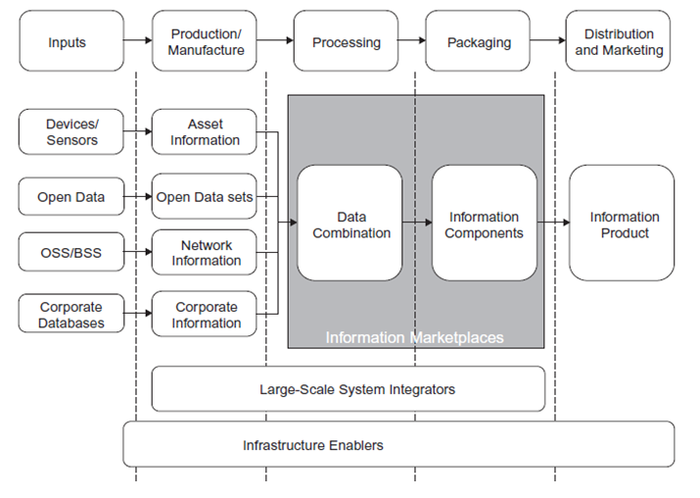
IOT VALUE CHAIN

Slide 91
IOT Value chain
Input | Significantly more inputs than for an M2M solution
Data sensors | Data from devices and sensors is used to provide a different and much broader marketplace then M2M does
Open data | A piece of data is open if anyone is free to use,resuse and redistribute it subject only at most the requirements of attribute and/or share alike Example: city maps, provided by organizations such as ordinance survey in the united kingdom
OSS/BSS | The operational support system (OSS) and Business support system closed information marketplace that allow operators to delivers services to enterprises. Example: where phone usage data is already owned by the company.
Corporate database | Companies of a certain size generally have multiple corporate database covering various functions, including supply chain management, payroll ,accounting .All the use of devices and sensors increases these database will be connected to this data to create new information sources and new knowledge.

Slide 92
IOT Value chain
Production/Manufacturer | Process will need to include tagging and linking of relevant data items in order to provide provenance and traceability across the information value chain
Asset Information | Asset information may include data such as temperature over time of container during transit or air quality during a particular month
Open data set | Maps, rail timetables or demographics about a certain area in a country or city
Network information | GPS data,services accessed via the mobile network
Corporate information | The current state of demand for a particular product in the supply chain at a particular moment in time
Processing | The data from the various inputs from the production and manufacture stage are combined together to create information

Slide 93
IOT Value chain
Packaging | The final stage of the information value chain is the creation of an information product
Distributed Marketing | The packaging section of the information value chain creates information components. These components could be produced as charts or other traditional methods of communicating information to end users
Information products for improving decision making | These information products are the results of ether detailed information analysis that allows better decision to be made during various internal corporate process, or they enable the creation of previously unavailable knowledge about company’s product, strategy or internal processes
Information product for resale to other economic actors | These information products have high value for other economic actors and can be sold to them

Slide 94
The Information-Driven Global Value Chain(I-GVC)
Fundamental roles within the I-GVC
1. Inputs:
Sensors, RFID, and other devices.
End-Users.
2.Data Factories.
3.Service Providers/Data Wholesalers.
4.Intermediaries.
5.Resellers.

Slide 95
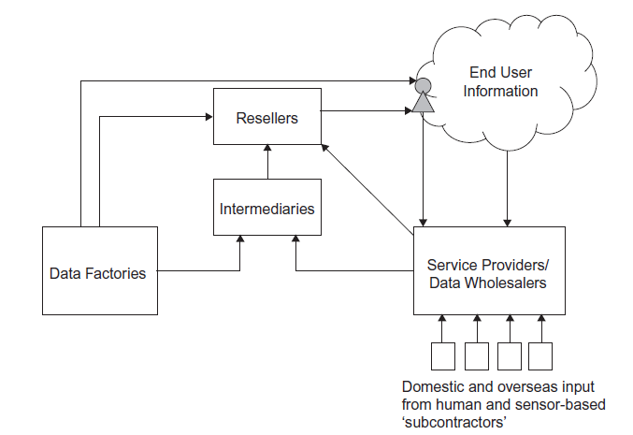
The Information-Driven Global Value Chain(I-GVC)

Slide 96
Inputs to the information-driven global commodity chain
1. Sensors and other devices (e.g. RFID and NFC).
2. End-users
Both of these information sources input tiny amounts of data into the I-GVC chain, which are then aggregated, analyzed, repackaged, and exchanged between the different economic actors that form the value chain.
As a result, sensor devices and networks, RFIDs, mobile and consumer devices, Wi-Fi hotspots, and end-users all form part of a network of “subcontractors” in the value chain, all contributing to the increased value of the information products.

Slide 97
Production processes of the information-driven global value chain
Data factories
Data factories are those entities that produce data in digital forms for use in other parts of the I-GVC.
Service providers/data wholesaler:
Service Providers and Data wholesalers are those entities that collect data from various sources worldwide, and through the creation of massive databases, use it to either improve their own information products or sell information products in various forms.
Example: Twitter, Facebook, Google

Slide 98
Processing and Pakaging
Intermediaries
In the emerging industrial structure of the I-GVC, there is a need for intermediaries that handle several aspects of the production of information products.
The development of databases such as the ones created by Google, Facebook, and Twitter may therefore require the creation of entities that are able to protect individuals’ privacy rights in relevant regional settings.
Intermediary is to reduce transaction costs associated with the establishment of a market for many different companies to participate in.

Slide 99
Distribution and Marketing
Resellers
Resellers are those entities that combine inputs from several different intermediaries, combine it together, analyze, and sell it to either end-users or to corporate entities.
These resellers are currently rather limited in terms of the data that they are able to easily access via the converged communications platform, but they are indicative of the types of corporate entities that are forming within this space.

Slide 100
An emerging industrial structure for IoT
M2M and IoT are about rapidly integrating data and workflows that form the basis of the global economy at increasing speed and precision
The emerging value chain and the roles that must be filled in order to create a flourishing IoT marketplace.

Slide 101
Existing RFID-installations in production and logistics today can be considered as an Intranet of Things or Extranet of Things.
The usability needs to be improved by providing flexible but simple devices and services to connect things and people.
Whereas the successful examples of Web 2.0, such as Facebook or Twitter, connect people with data, this is achieved by proprietary Application Programming Interfaces (APIs) that do not provide powerful data-sharing models capable of Business-to-Business (B2B) requirements, such as data management and analysis

Slide 102
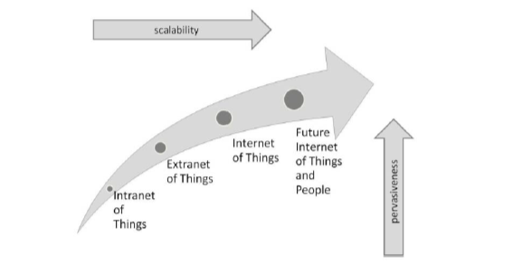
Future of Internet of Things

Slide 103
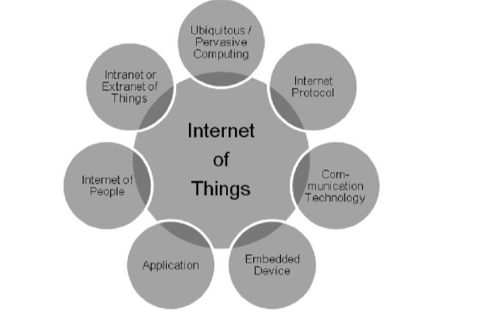
Functional Requirements
The Internet of Things is not the Internet of People and it is not the Intranet or Extranet of Things. Therefore, applications that provide only access to a small group of stakeholders (e.g., few companies) should not be considered to represent the full scope of the Internet of Things

Slide 104
The second problem in the CERP-IoT definition is the missing Web 2.0integration. One could argue that the Web 2.0 is exemplified only by certain types of applications in the Internet of People, which again is not equal to the Internet of Things. However, the Web 2.0 has changed usage of the WWW by providing more intuitive interfaces for user interaction, social networking and publication of user-generated content, without requiring fundamental changes to the design and existing standards of the internet.

Slide 105
Opportunities and Motivation
Envision
Extend
Enable
Excite
Evaluate

Slide 106
Key requirements that need to be considered in the Internet of Things
Meet key societal needs for the Internet of Things including open governance, security, privacy and trustworthiness
Bridge the gap between B2B, business-to-consumer (B2C) and machine to-machine (M2M) requirements through a generic and open Internet of Things infrastructure.
Design an open, scalable, flexible and sustainable infrastructure for the Internet of Things.

Slide 107
Develop migration paths for disruptive technological developments to the Internet of Things.
Excite and enable businesses and people to contribute to the Internet of Things.
Enable businesses across different industries to develop high added value products and services
Encourage new market entrants, such as third party service and information providers, to enter the Internet of Things.
Provide an open solution for sharing costs, benefits and revenue generation in the Internet of Things

Slide 108
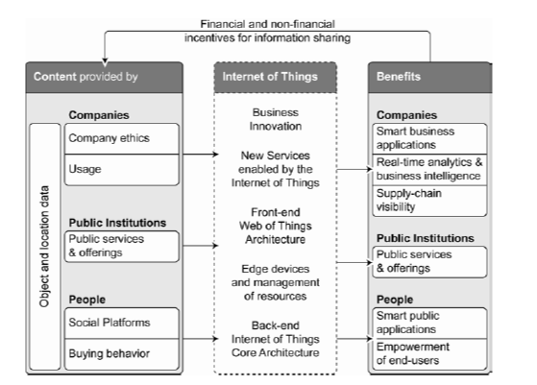
Scenario for the Future Internet of Things

Slide 109
Key goals for a future Internet of Things architecture to achieve are:
An open, scalable, flexible and secure infrastructure for the Internet of Things and People
A user-centric, customisable ‘Web of Things’ including interaction possibilities for the benefit of society
New dynamic business concepts for the Internet of Things including flexible billing and incentive capabilities to promote information sharing

Slide 110

EPC Global IOT Architecture

Slide 111
The EPC global Network architecture components
Extended static data support
Integration of dynamic data
Support for non-IP devices
Integration of an actuator interface
Optional integration of software agents
Extended, federated discovery services
Data-synchronisation for offline support
Interface to federated billing services

